Slide 1
WORKING WITH LAND MANAGERS
WHO YA GONNA CALL

Slide 2
Who ARE you going to call?
USDA FOREST SERVICE
US FISH AND WILDLIFE
NATIONAL PARKS
BUREAU OF LAND MANAGEMENT
WASHINGTON STATE DEPT. OF NATURAL RESOURCES
WASHINGTON STATE FISH AND WILDLIFE
WASHINGTON STATE PARKS
COUNTY PARKS
DEPARTMENT OF RECLAMATION
LOCAL CITY AND REGIONAL PUBLIC AGENGIES
*PRIVATE TIMBER COMPANIES and PRIVATE LANDS

Slide 3
WHY are you going to call?
You want information
You are planning a ride
You have a concern
You need a sign
OR
You want to initiate a project

Slide 4
My favorite sign
A collaboration of the
Wind River Back Country Horsemen of Wyoming
and
Dept. of Interior, Bureau of Land Management
and
Lander Cycling Club

Slide 5
Tracking projects
USDA US Forest Service
Schedule of Proposed Actions
www.fs.usda.gov/sopa/
NEPA – National Environmental Policy Act (Federal Agencies)
CE – Categorical Exclusion
Comment Period
Washington State Dept. Of Natural Resources
SEPA - State Environmental Policy Act

Slide 6
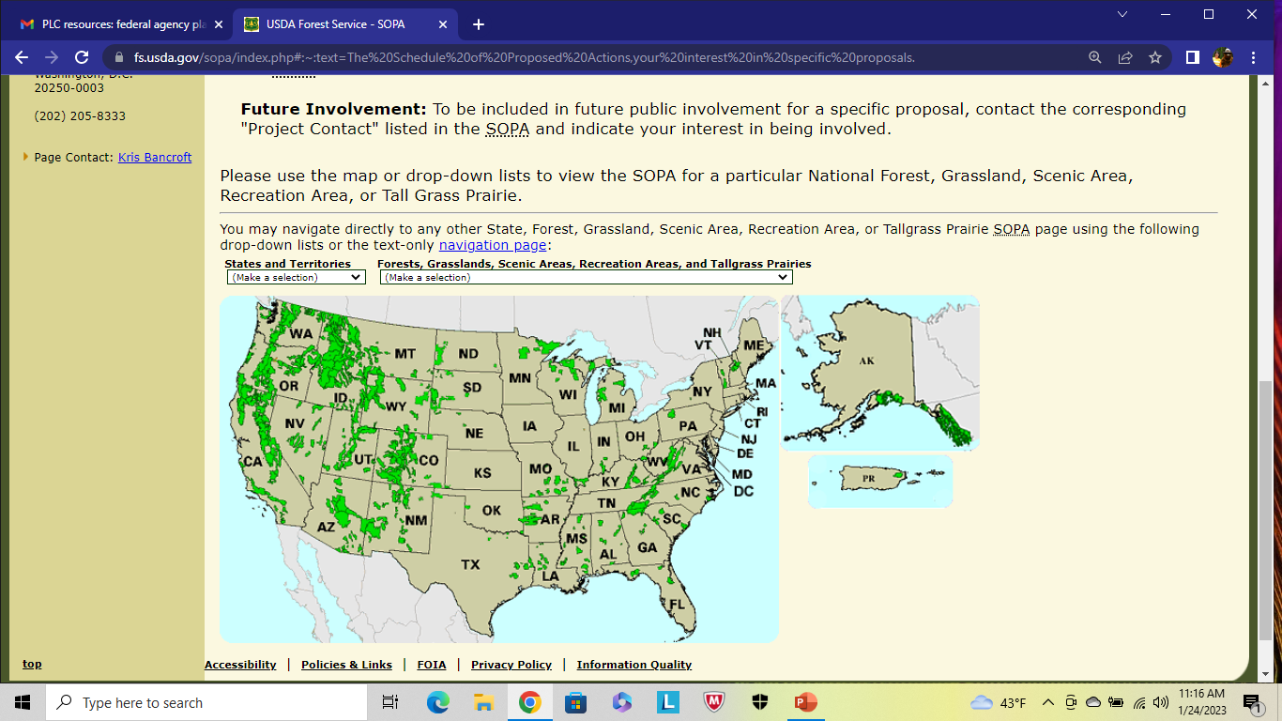
Federal Agency Planning sites
Planning pages for projects and NEPA documents for federal public lands in your state or area:
1. US Forest Service Schedule of Proposed Actions (SOPA):
https://www.fs.usda.gov/sopa/index.php#:~:text=The%20Schedule%20of%20Proposed%20Actions,your%20interest%20in%20specific%20proposals.
2. National Park Service Park Planning Page:
https://parkplanning.nps.gov/publicHome.cfm
3. BLM e-planning website:
https://eplanning.blm.gov/eplanning-ui/home

Slide 7
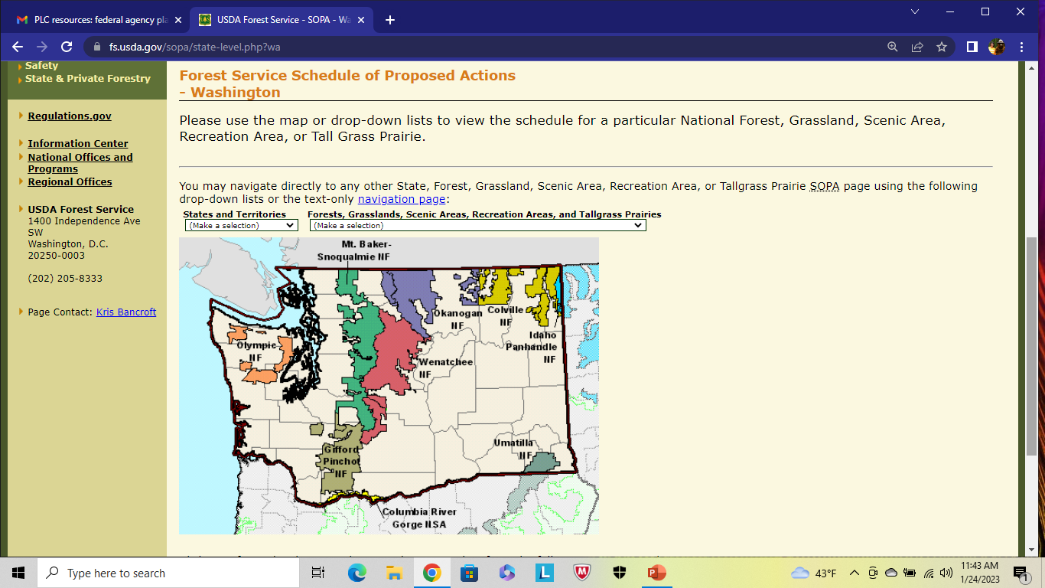

Slide 8
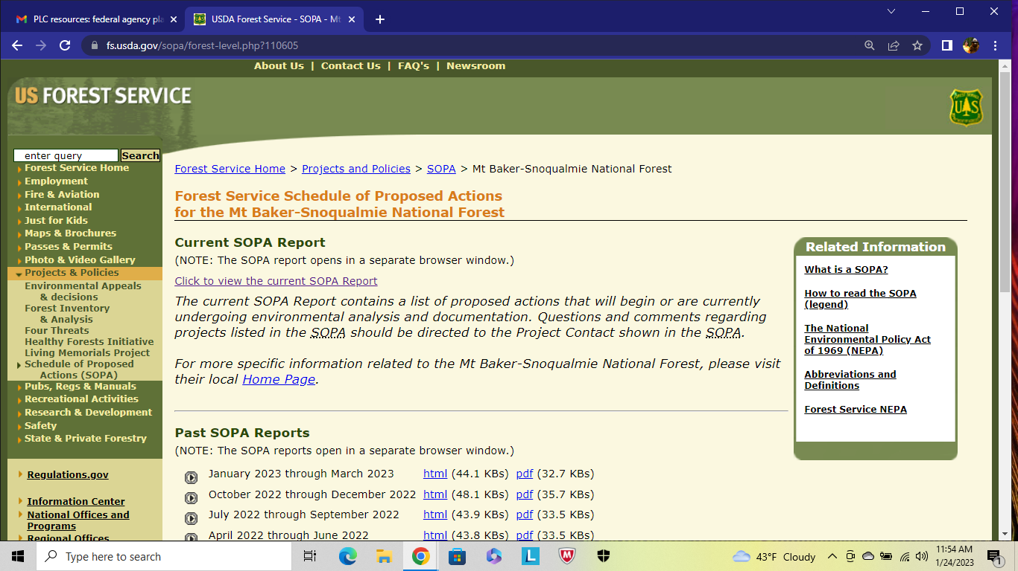

Slide 9
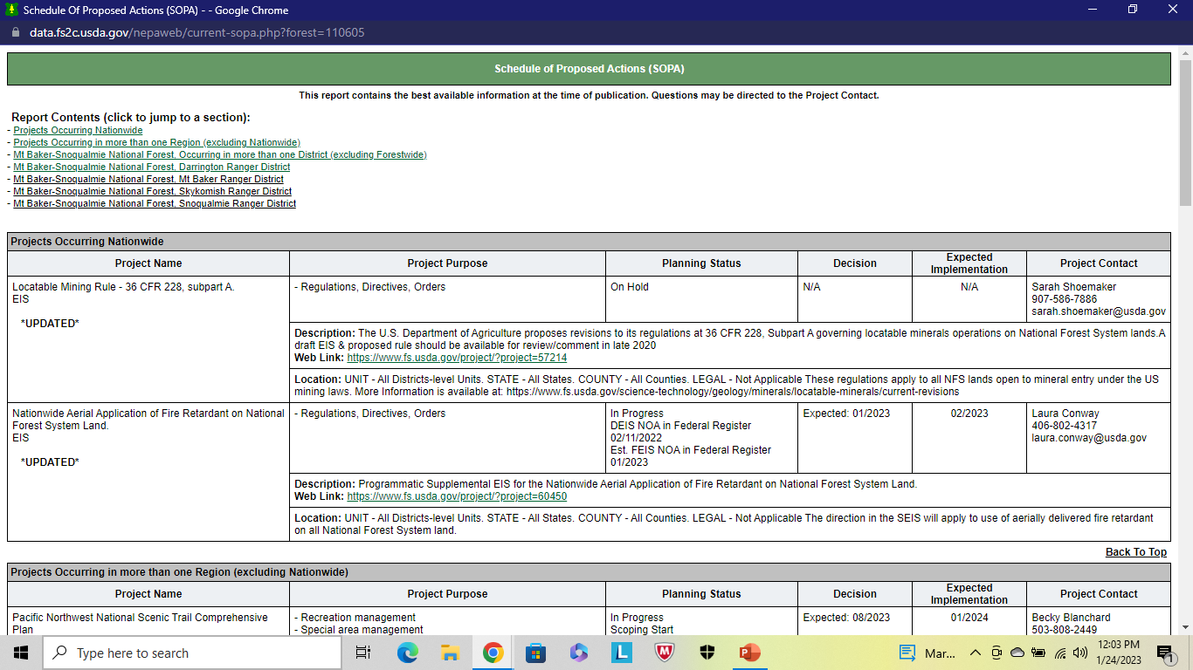

Slide 10
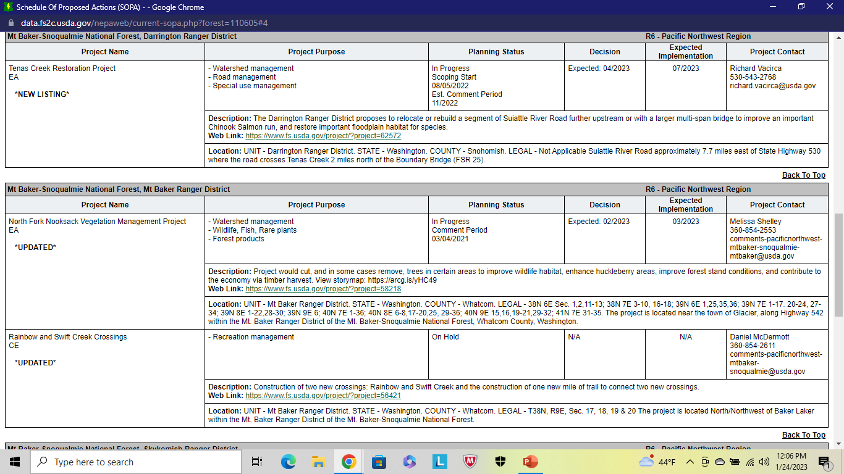

Slide 11
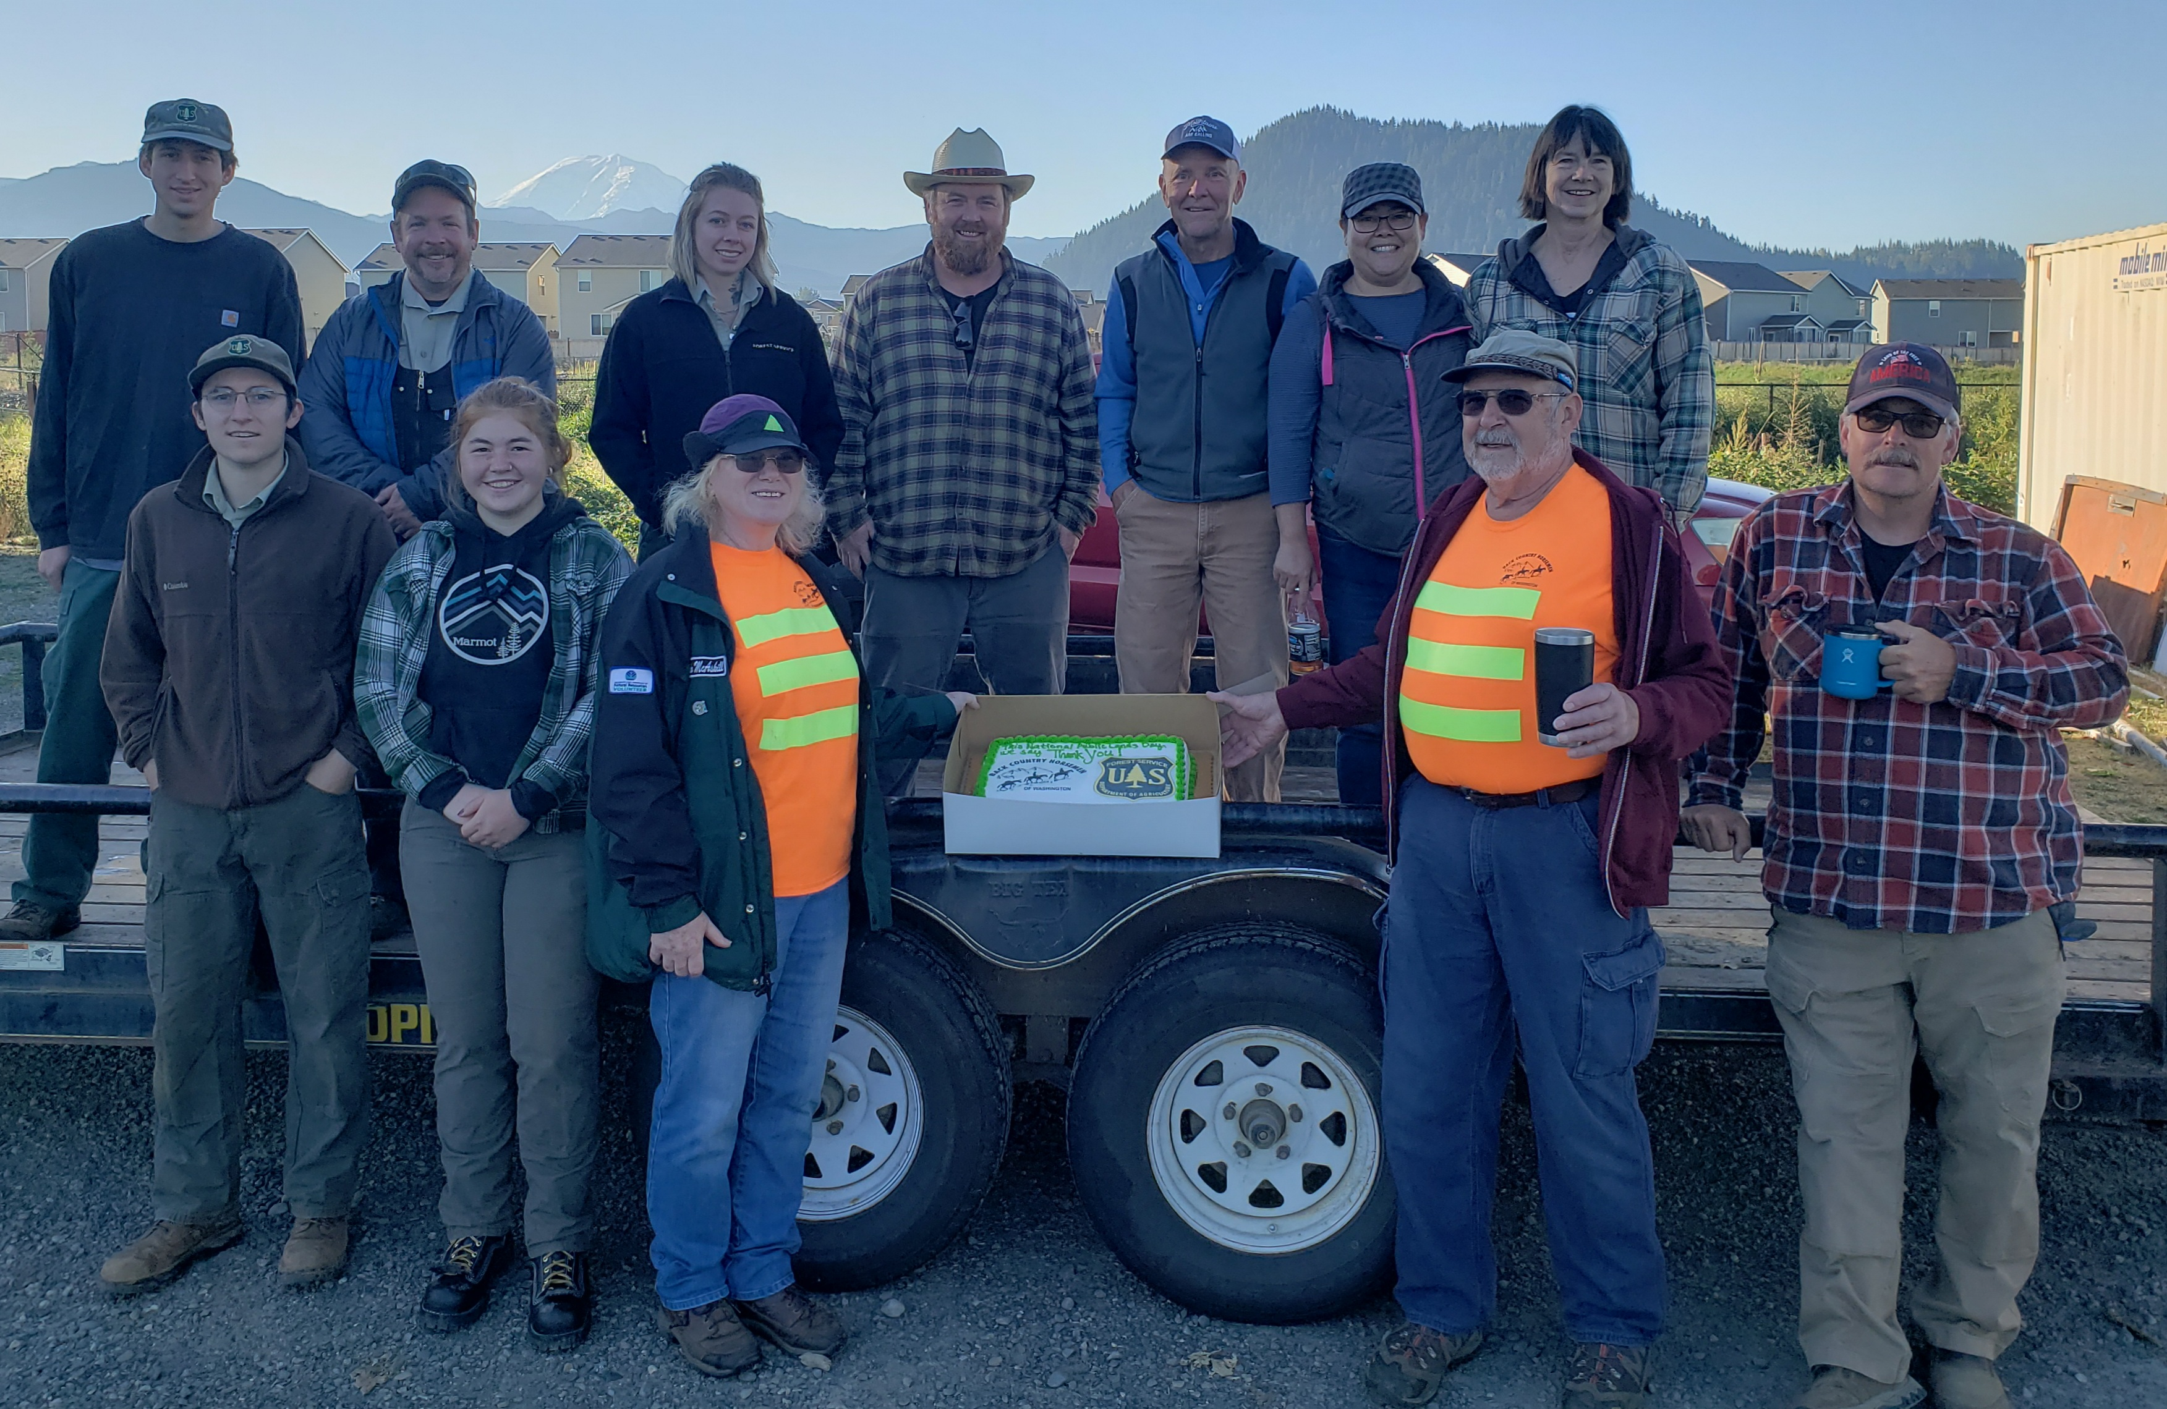

Slide 12
WHO makes the contact ? WHO is the contact ?
AGENCY
Forest Service
Forest Level, District Ranger, Recreation Staff
Is the Forest asking for a SPC Single Point of Contact for planning purposes?
DNR , State Parks, Fish and Wildlife, etc
BCHW
Chapter Level, Trail Projects Leader, State Level
PARTNER ORGANIZATIONS

Slide 13
BCHW Public Lands Committee
Regional Contacts with a monthly phone call
Is this concept working? Are there better ideas?

Slide 14
Grants
Support Letters
Legislative
Volunteer Hours
Land Manager Agreements
Forest Service – Volunteer Service Agreement 301a

Slide 15
Wilderness Act
Volunteer Services Agreement – Forest Service
DNR - Adopt?

Slide 16
RESOURCES
FEDERAL
USDA Forest Service www.fs.usda.gov/sopa/
National Parks Planning https://parkplanning.nps.gov/publicHome.cfm
BLM e-planning Website https://eplanning.blm.gov/eplanning-ui/home
STATE
Dept. of Natural Resources (DNR) https://www.dnr.wa.gov/projects
Washington Dept. of Fish and Wildlife https://wdfw.wa.gov/get-involved
Washington State Parks https://www.parks.wa.gov/Search?searchPhrase=Planning

Slide 17
definitions
NEPA – National Environmental Policy Act (Federal)
CE – Categorical Exclusion
EA – Environmental Assessment

